Slide 1
Travel ai agent
IBM PROJECT
Presented By: Manvardhan Tripathi
College Name & Department : Madan Mohan Malviya University Of Technology, Gorakhpur and CSE Department

Slide 2
OUTLINE
Problem Statement
Technology used
Wow factor
End users
Result
Conclusion
Git-hub Link
Future scope
IBM Certifications

Slide 3
Problem Statement
Travel Planner Agent
The Challenge - A Travel Planner Agent is an AI-powered assistant that helps users plan trips efficiently and intelligently. It uses real-time data to suggest destinations, build itineraries, and recommend transport and accommodation options. By understanding user preferences, budgets, and constraints, it tailors personalized travel plans. Integrated with maps, weather updates, and local guides, it ensures a smooth travel experience. The agent can also manage bookings, alert users to changes, and optimize schedules on the go. This smart assistant transforms complex travel planning into a seamless, enjoyable process.
Proposed Solution- Solution is a multi-layered, AI-driven platform designed to be a seamless, end-to-end travel planning assistant. It will integrate cutting-edge AI technologies with a user-friendly interface to transform the complex process of travel planning into a personalized and enjoyable experience.
1. Core AI Engine and Data Integration
2. User Interface and Interaction
3. Proactive Assistance and On-the-Go Optimization
4. Business Model and Monetization

Slide 4
Technology used
IBM cloud lite services
Natural Language Processing (NLP)
Retrieval Augmented Generation (RAG)
IBM Granite model

Slide 5
IBM cloud services used
IBM Cloud Watsonx AI Studio
IBM Cloud Watsonx AI runtime
IBM Cloud Agent Lab
IBM Granite foundation model

Slide 6
Wow factors
Anticipatory Assistance and Proactive Problem Solving
Conversational, Multimodal Trip Design
Hyper-Personalized Itineraries and Recommendations
Your Personal, On-the-Go Concierge
Seamless and Secure Biometric Check-ins

Slide 7
End users
1. Individual Travelers
2. Business Travelers
3. Travel Agencies and Tour Operators
4. Airlines, Hotels, and Hospitality Companies

Slide 8
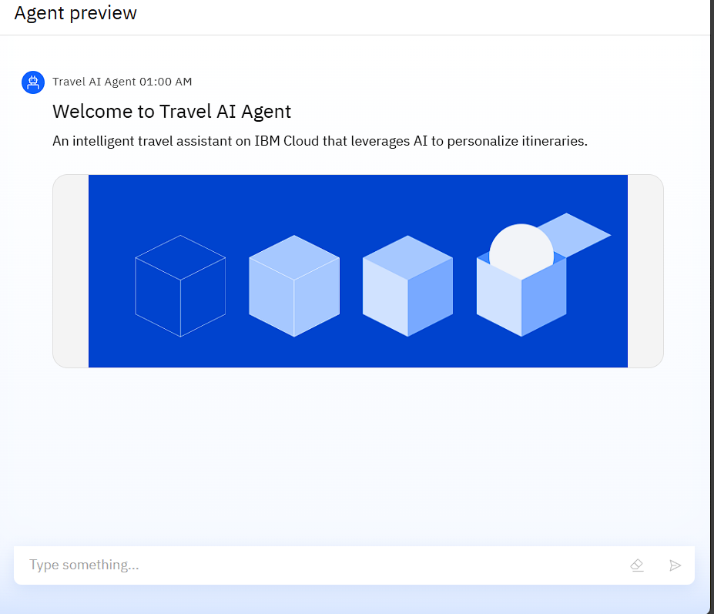
Results

Slide 9
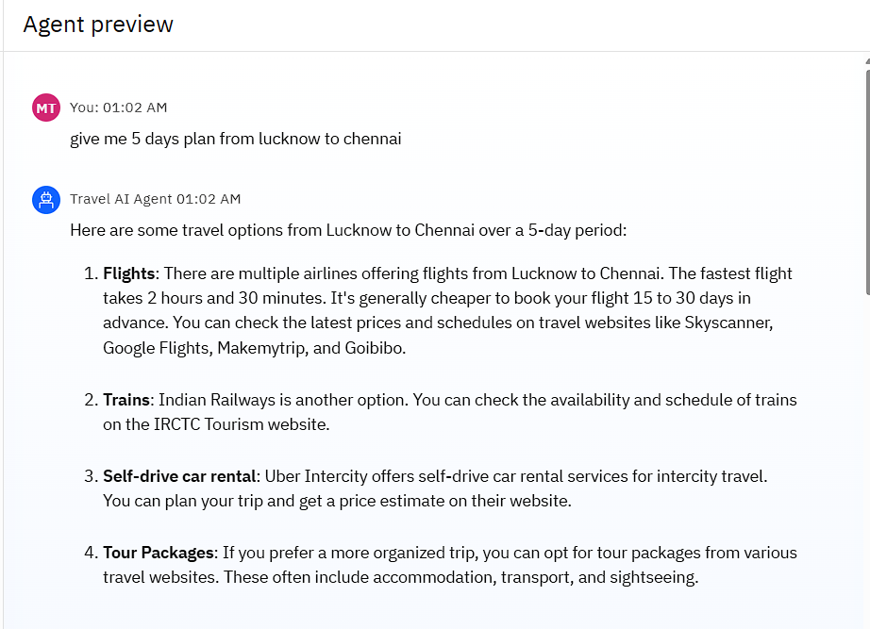
Results

Slide 10
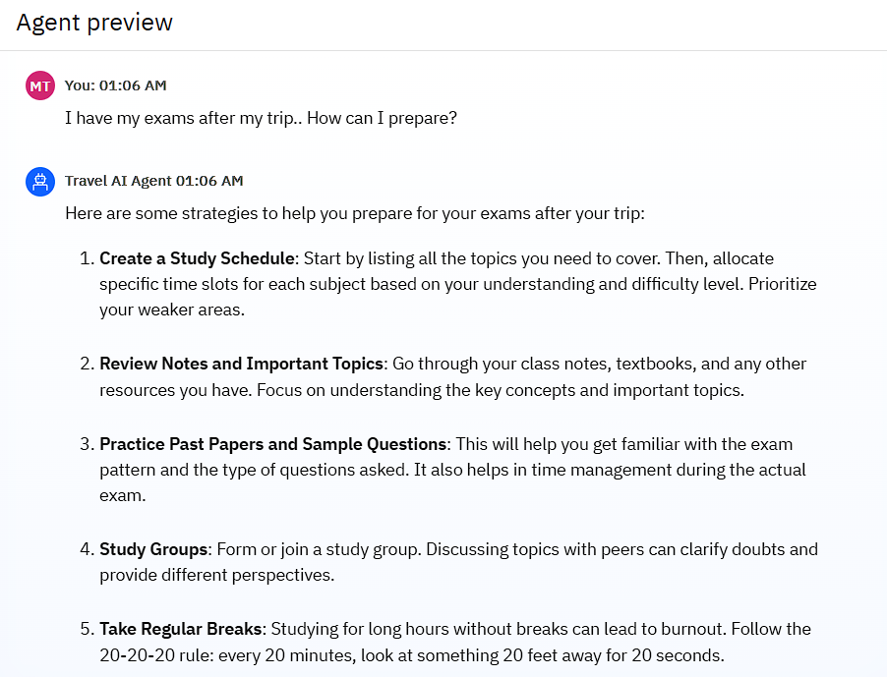
Results

Slide 11
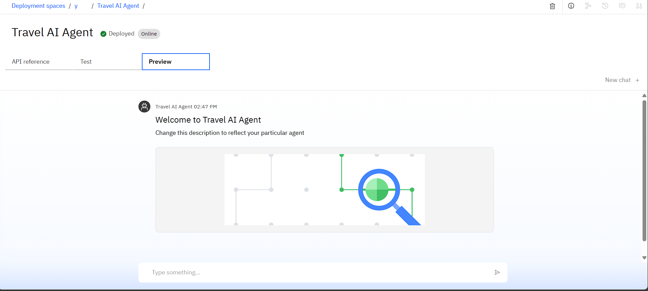
Results
Deployed AI Agent

Slide 12
Conclusion
The travel AI agent is evolving from a simple booking tool into a proactive, intelligent travel companion. It no longer just finds flights and hotels; it anticipates needs, manages disruptions, and curates experiences that are deeply personal and relevant.
The ultimate goal is not to replace the human element of travel but to enhance it. By automating the logistical burdens of travel—such as rebooking flights during delays or handling complex itineraries—the AI agent frees up travelers to focus on the joy and discovery of their journey.
AI agents are the key to unlocking true hyper-personalization in travel. By analyzing vast amounts of data, they can move beyond generic recommendations to offer a unique, bespoke trip for every individual, creating a sense of being truly seen and understood by the technology.
The user experience is becoming more natural and conversational. Travelers can interact with AI agents using voice, text, and even images to plan and manage their trips, making the process feel less like a transaction and more like a collaboration with a knowledgeable friend.

Slide 13
GitHub Link
https://github.com/Maan-netizen/IBM.git

Slide 14
Future scope
Hyper-Personalized and Dynamic Itineraries
Proactive Disruption Management and Autonomous Rebooking
Multi-Modal and Conversational Interfaces
Seamless Integration and All-in-One Platforms
Enhanced Post-Booking Support

Slide 15
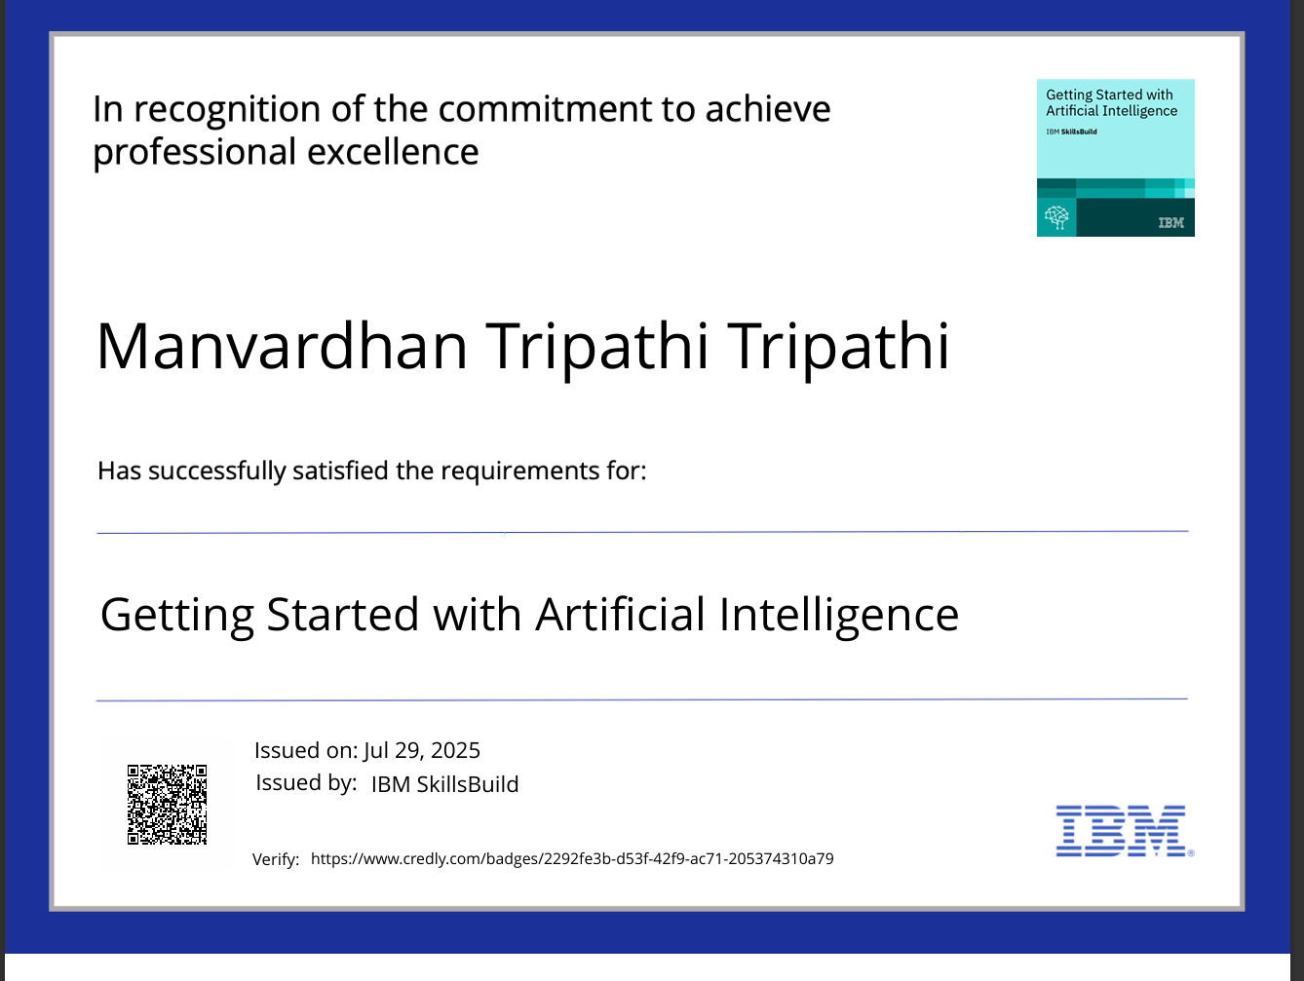
IBM Certifications

Slide 16
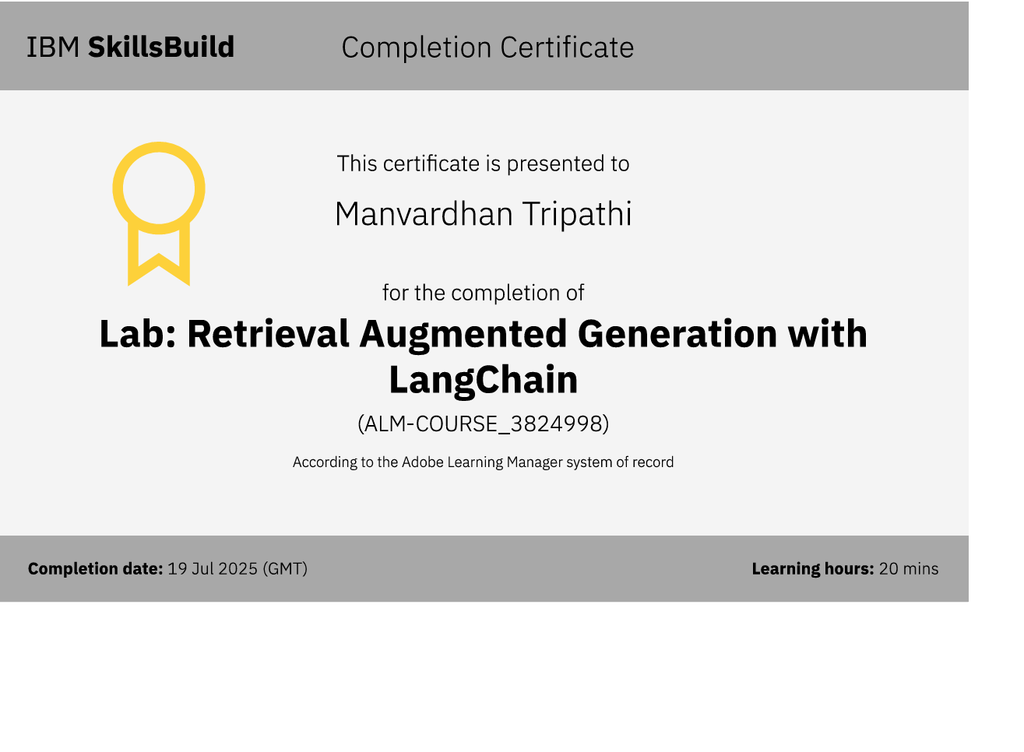

Slide 17
THANK YOU

